Slide 1
Novelty aware recommendations on Steam
Studying the tradeoff between accuracy and novelty using EASE reranking
Nabil El Ouaamari

Slide 2
Research Questions
How does re-ranking EASE recommendations using genre-based item-to-history cosine novelty affect the accuracy-novelty trade-off?
Can user-specific novelty weighting, where users are grouped based on profile characteristics, improve the accuracy-novelty trade-off compared to a single global novelty weight?
2
Notes:
[RQ]; which basically means that What happens if we take a standard EASE recommender and re-rank its recommended games based on how novel they are in terms of genres. I use genres because they are a very natural way to define novelty for games. If a user mostly plays Action, then a pure Puzzle or Strategy game is more surprising than yet another Action title. In principle I could have used other signals, like tags, playtime patterns, but genres are simple which keeps the analysis focused.
[RQ]; This is a follow up to the first RQ where we use a single global weight for all users, whereas here we put users in certain groups where each group has a certain novelty weight.
Throughout this, I use EASE as the baseline model, because it is well understood method for implicit feedback. That makes it easier to study the effect of the novelty.

Slide 3
Methodology
1. Build user-item interaction matrix from implicit data
2. Train EASE baseline, tune regularization λ, pick λ = 300
3. Compute genre based item-item similarities and distances
4. Compute item to history novelty scores for each user and candidate item
5. Rerank EASE scores
    Global novelty weight
    User specific novelty weight (profile, genre, combined)
6. Evaluate accuracy and novelty metrics
7. Discuss tradeoffs and answer RQs
Notes:
This slide shows the full pipeline I used to answer the research questions.
First, I build a standard user item interaction matrix from the implicit data. Each row corresponds to a user, each column to a game, and a 1 means that user has interacted with that game.
On top of this matrix I train the EASE baseline model. Its only hyperparameter is a regularization lambda, which controls how much we smooth the item-item correlations.
I ran a lambda sweep and found that λ equal to 300 gives a strong NDCG on Codabench evaluation, so I use 300 for my baseline and for the other experiments.
Next, I compute genre based similarities and distances. Each game gets a genre vector, and from that I compute cosine similarity and distance.
Then I compute an item to history novelty score for each candidate game and each user, and then re-rank the EASE list.
I test both a global novelty weight for all users and user specific novelty weights.
Finally, I evaluate and then discuss the tradeoffs to answer my RQs.

Slide 4
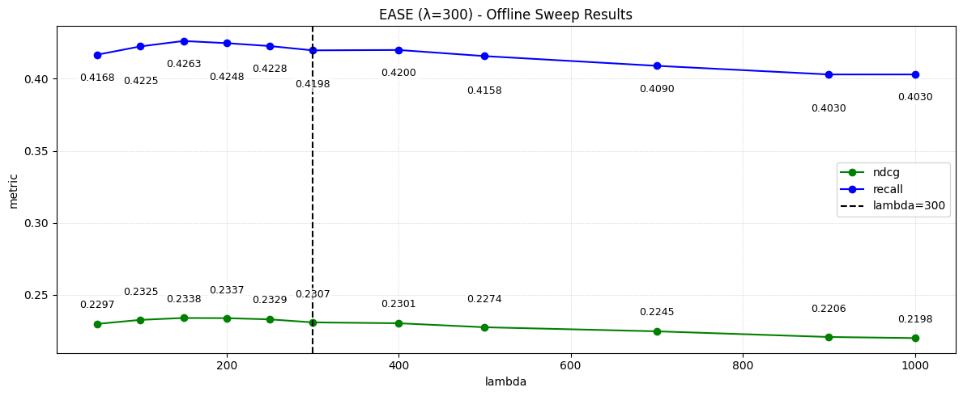
Results: EASE sweep (offline)
Notes:
Here I tune the parameter lambda for EASE. Using Offline evaluation based on a subset of users, both NDCG and recall increase when I move away from very small lambda, peak roughly around 150, and then slowly decline.
I also checked a few values on Codabench, and there lambda equal to 300 gave the best NDCG. So for the rest of the project I fix lambda at 300.
“”As λ increases, stronger regularization pushes many item weights toward zero. The model then plays it safe by recommending fewer, more frequent items, so item coverage drops.
For the same reason, recommendations concentrate on a small set of popular items. That makes the distribution more unequal, so the item Gini coefficient increases.
“”

Slide 5
EASE under the hood
user | Half Life 2 | Portal | Terraria | Killing Floor
u0 | 1 | 1 | 1 | 0
u1 | 1 | 0 | 1 | 1
u2 | 1 | 0 | 0 | 1
$G=X^{T}X=\left[\begin{matrix}3 & 1 & 2 & 2 \\ 1 & 1 & 1 & 0 \\ 2 & 1 & 2 & 1 \\ 2 & 0 & 1 & 2\end{matrix}\right]$
$X=\left[\begin{matrix}1 & 1 & 1 & 0 \\ 1 & 0 & 1 & 1 \\ 1 & 0 & 0 & 1\end{matrix}\right]$
$G_{λ=10}=G+λI=\left[\begin{matrix}13 & 1 & 2 & 2 \\ 1 & 11 & 1 & 0 \\ 2 & 1 & 12 & 1 \\ 2 & 0 & 1 & 12\end{matrix}\right]$
$B=−\frac{P}{diag\left(P\right)}≈\left[\begin{matrix}0 & 0.06 & 0.11 & 0.12 \\ 0.08 & 0 & 0.08 & −0.03 \\ 0.11 & 0.11 & 0 & 0.10 \\ 0.12 & −0.03 & 0.10 & 0\end{matrix}\right]$
$P=G_{λ}^{−1}$
Notes:
Here I summarize how EASE actually works.
The starting point is the interaction matrix X, where each row is a user and each column is an item.
If a user has played a game at least once, the entry is 1, otherwise 0.
For example, user u2 has interacted with item 0 and item 3, so their row is basically "1, 0, 0, 1".
From that matrix we build an item-item co-occurrence matrix. You can think of this as counting how often games are played by users.
The diagonal is how many users played a given game, and the off diagonal entries tell us how often two games appear together in people’s histories.
Next EASE adds a regularization constant lambda on the diagonal of that co-occurrence matrix to make the inversion stable and to avoid overfitting.
“”Small λ lets the model follow the data very closely, which can overfit to rare co occurrences.
Larger λ shrinks the item item weights and smooths them, which makes the inverse more stable and the recommendations less noisy.
“”
After inverting it, we derive an item-item weight matrix B.
Each row of B says: to predict interest in this game, how much do the other games contribute. We explicitly zero the diagonal so a game is not allowed to recommend itself.

Slide 6
EASE under the hood
user | Half Life 2 | Portal | Terraria | Killing Floor
u0 | 1 | 1 | 1 | 0
u1 | 1 | 0 | 1 | 1
u2 | 1 | 0 | 0 | 1
$x_{u2}=\left[1,0,0,1\right]$
${scores}_{u}=x_{u}⋅B$
Item | score | Seen by u2
Half life 2 | 0.225 | yes
Portal | 0.142 | no
Terraria | 0.217 | No
Killing floor | 0.188 | yes
Notes:
To score a user like u2, we take their interaction row ("1, 0, 0, 1") and combine it with matrix B.
The model looks at all games u2 has played and sums up how strongly they point to every other game. This produces one score per game.
Then we set the scores of already played games (here items 0 and 3) to a very low value so they will never be recommended.
Finally we sort the remaining games by score and take the top K. For u2, that would mean items 2 and 1 come out on top as new recommendations.

Slide 7
Novelty: genre based item to history score
Represent each game with a multi hot genre vector (Action, RPG, Strategy, …)
For a user and a candidate game:
  compare the candidate’s genres to each game in the user’s history using cosine similarity
  Genres overlap → high similarity
  convert similarity to distance: Distance = 1 − similarity
  Distance close to 1 → genres different from what the user usually plays → more novel
  Per candidate game take average of these distances → item to history novelty
7
Notes:
To measure novelty I use the genres of each game. Every game has one or more genres, like Action, RPG or Strategy. I turn that into a simple vector of zeros and ones, where one means the game has that genre.
For a given user and a candidate game, I look at all the games in that user’s history. I compare the candidate’s genre vector with each of those using cosine similarity.
If the genres overlap a lot the similarity is high otherwise its lower. I then turn that into a distance by doing one minus the similarity, so higher distance means the game is more different from what they usually play.
For that candidate game I take the average of these distances over all games in the user’s history.
That gives me an item to history novelty score.

Slide 8
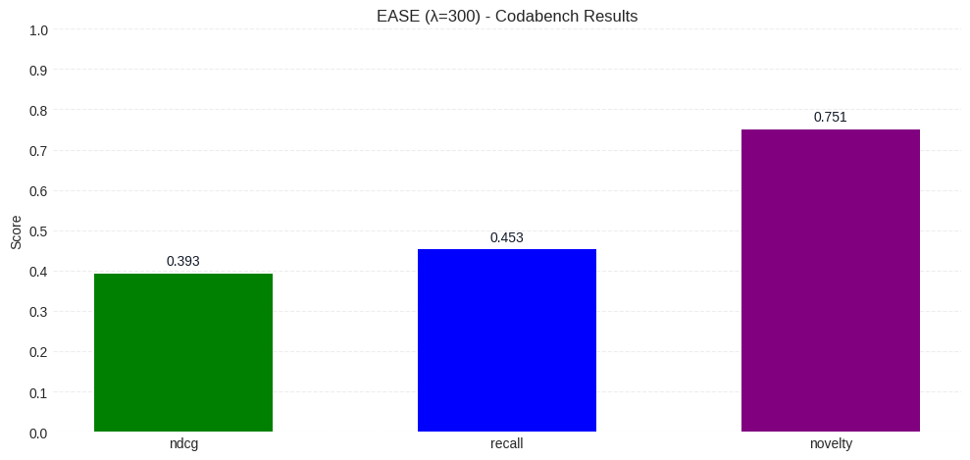
Results: Baseline EASE performance (λ = 300, online)
Notes:
This is my baseline model: plain EASE with λ = 300, evaluated on Codabench.
You can see it reaches an NDCG of about 0.24 and a recall of about 0.45, so it retrieves quite a lot of the relevant games but the ranking quality is more modest.
Novelty about 0.76, so EASE already gives a good novelty sore.
Other results will be compared back to this baseline.

Slide 9
Results: global novelty re-ranking
Reminder RQ: How does re-ranking EASE recommendations using genre-based item-to-history cosine novelty affect the accuracy-novelty trade-off?
Take recommendations produced by EASE for each user
For each candidate game compute the novelty score
Update scores:
Use one global novelty weight λ_{nov} for all users
Sweep different λ_{nov} values to study the accuracy vs novelty trade off
$s′\left(u,i\right)=S_{EASE}\left(u,i\right)+λ_{nov}⋅novelty\left(u,i\right)$
Notes:
On this slide I explain how I actually use novelty in the ranking.
First, I take the recommendations produced by EASE for each user. For every candidate game in that list I compute the novelty score based on genres, that measures how different its genres are from the games in that user’s history.
novelty(u,i): average genre distance between I and all items in the user’s history
I then adjust the EASE score by adding a weight times the novelty score. When lambda is zero I recover plain EASE. When lambda is larger, more novel games move up in the list.
In this experiment I use a single global weight for everyone and test several values to see the trade-off.

Slide 10
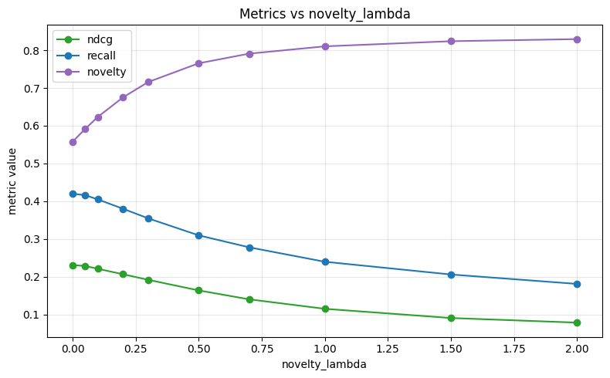
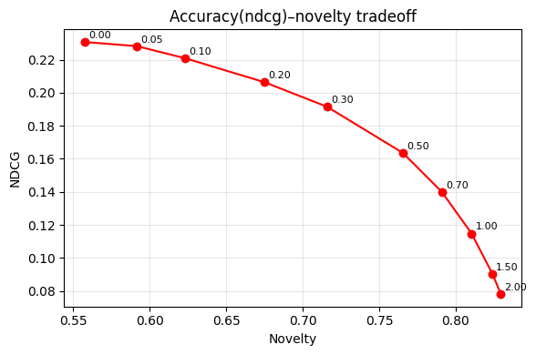
Results: global novelty re-ranking (offline)
Reminder RQ: How does re-ranking EASE recommendations using genre-based item-to-history cosine novelty affect the accuracy-novelty trade-off?
Notes:
On this slide I show what happens when I turn up the global novelty weight lambda.
In the left plot you see the three metrics as a function of lambda. At zero we are at plain EASE. As I increase lambda, novelty goes up strongly, while both NDCG and recall go down in a smooth way. Around lambda equal to 0.3 I still keep a reasonable NDCG and recall, but novelty is clearly higher than the baseline.
The right plot shows the same story more compactly. Each point is one lambda, and you can see that every gain in novelty costs some accuracy. This answers the main research question. Genre based item to history novelty gives me a clear accuracy novelty trade off. If I am willing to lose some NDCG, I can systematically push the recommendations toward more novel games.

Slide 11
Method: user specific novelty weighting
Reminder sub-RQ: Can user-specific novelty weighting, where users are grouped based on profile characteristics, improve the accuracy–novelty trade-off compared to a single global novelty weight?
Update score:
1. Profile size groups (# interactions)
  Low < 15: λ_{nov} = 0.1
  Medium 15-50: λ_{nov} = 0.2
  High ≥ 50: λ_{nov} = 0.3
2. Genre diversity group (entropy of genres)
  Low / medium / high: λ_{nov} = 0.1 / 0.2 / 0.3
3. Combined variant: λ_{nov} = average(profile λ_{nov} , genre λ_{nov})
$s′\left(u,i\right)=S_{EASE}\left(u,i\right)+λ_{u}⋅novelty\left(u,i\right)$
Notes:
Up to now I used a single global novelty weight for everyone. For the next research question I give each user their own novelty weight.
The re-ranking formula stays the same: for every candidate game I take the original EASE score and add λᵤ times the novelty.
To set λᵤ I try three strategies. First, profile size. I count how many games a user has played. Small profiles get a low λᵤ of 0.10, medium profiles 0.20, and large profiles 0.30.
Second, based on the entropy of the genres in the user’s history and split users into low, medium and high diversity. Again I assign 0.10, 0.20 or 0.30.
High diversity users are treated as more open to novel genres.
Finally, I have a combined setup that just averages the profile based and genre based weights.

Slide 12
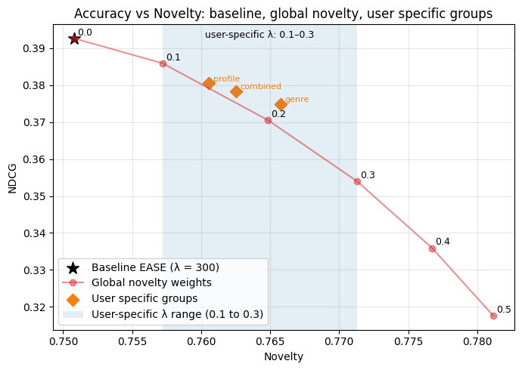
Results sub-RQ: user specific novelty weighting
Reminder sub-RQ: Can user-specific novelty weighting, where users are grouped based on profile characteristics, improve the accuracy–novelty trade-off compared to a single global novelty weight?
Black star: EASE baseline with fixed λ = 300
  NDCG ≈ 0.3927, Novelty ≈ 0.7508
red curve: global novelty weight λ_{nov}
  Increasing λ_{nov} moves you to the right (more novelty) and down (lower NDCG)
Orange diamons: user specific novelty weights
  Profile based, Genre diversity based and combined
  These give a better tradeoff if you were to choose within that region. (0.1 – 0.3)
Notes:
So the main takeaway from this sub-RQ is that my simple three-group scheme did not improve the overall trade-off as much as I hoped,
although it still demonstrates how per-user novelty control changes where you sit on the accuracy-novelty curve.

Slide 13
Discussion & Conclusion
Main RQ: global novelty re ranking
  Adding genre based novelty on top of EASE produces a clear accuracy-novelty tradeoff
  Moderate novelty weights increase novelty with acceptable NDCG loss
  Strong novelty weights give higher novelty but hurt NDCG more
Sub RQ: User specific novelty weights
  Simple three group scheme (profile size, genre entropy, combined)
  Performs better than using a global weight
Notes:
“”
Other things I could have tried:
- instead of profile size or genre, maybe avg playtime
- instead of using buckets where users can be in, I could perhaps learn the best lambda weight per user by doing a validation split
””

Slide 14
Any Questions ?
Nabil El Ouaamari

